Slide 1


Data Insights Presentation

Slide 2


Today's agenda
Project recap
Problem
The Analytics team
Process
Insights
Summary

Slide 3

Objective:
To analyze user reactions to various content categories and identify key trends and insights.
Scope:
Data includes user reactions across multiple categories over a specified time period.
Focused on identifying the most engaging categories and the types of reactions.
Methodology:
Data Collection: Gathered from user interactions recorded in the system.
Data Analysis: Processed and analyzed to identify patterns and trends.
Key Metrics:
Reaction Types (e.g., disgust, dislike, scared, interested)
Content Categories
Scores and Monthly Trends
Project Recap

Slide 4
Problem
How many unique categories are there?
How many reactions are there to the most popular category?
What was the month with the most posts?

Slide 5
Andrew Fleming (Chief Technical Architect)
Marcus Rompton (Senior Principle),
Shanmukham Thatikonda(Data Analyst intern)
The Analytics team

Slide 6
Data Collection: Aggregated data from various sources including user posts, reactions, and category classifications.
Process
1
2
Data Cleaning: Ensured data quality by removing duplicates and correcting inconsistencies.
3
Data Analysis: Conducted statistical analysis to identify key trends and patterns.
4
Visualization: Created charts and graphs to visualize the data for better understanding.
5
Insight Generation: Derived insights from the visualizations to inform content strategy.

Slide 7

Insights
Total Unique Categories: 29
Reactions to Most Popular Category: 71,242
Month with Most Posts: May
Most Popular Category: Animals
Analysis of Top Categories:
Examined the top 5 categories driving engagement.
Analyzed the distribution of posts and reactions across these categories.

Slide 8
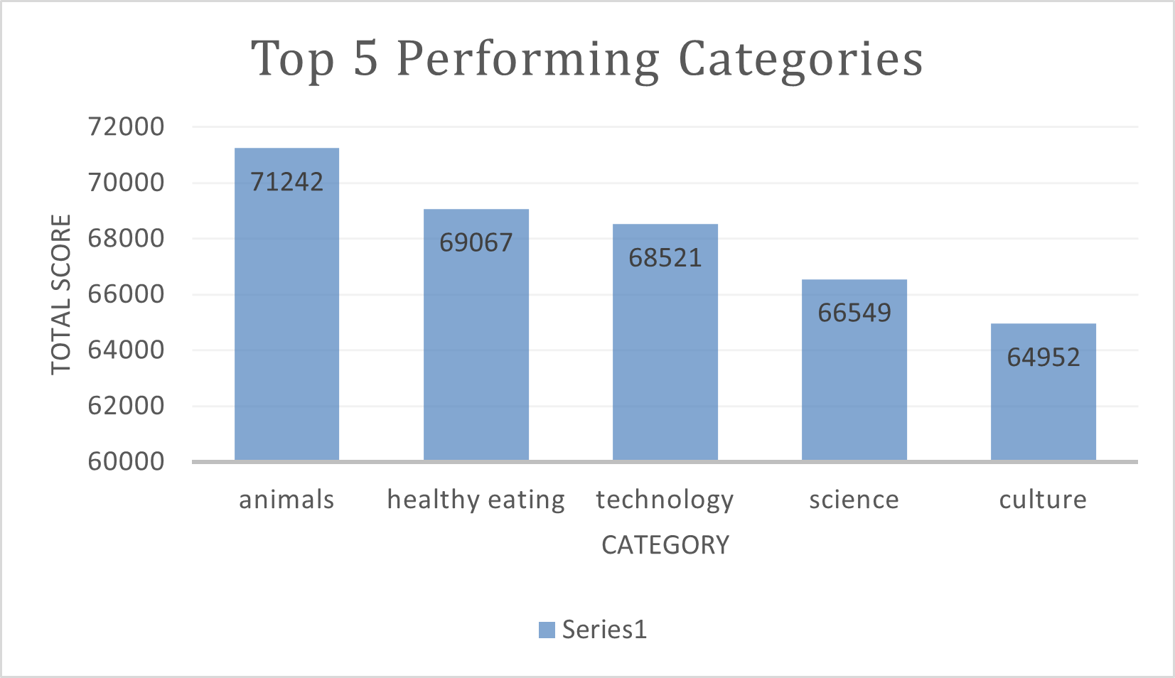

Slide 9
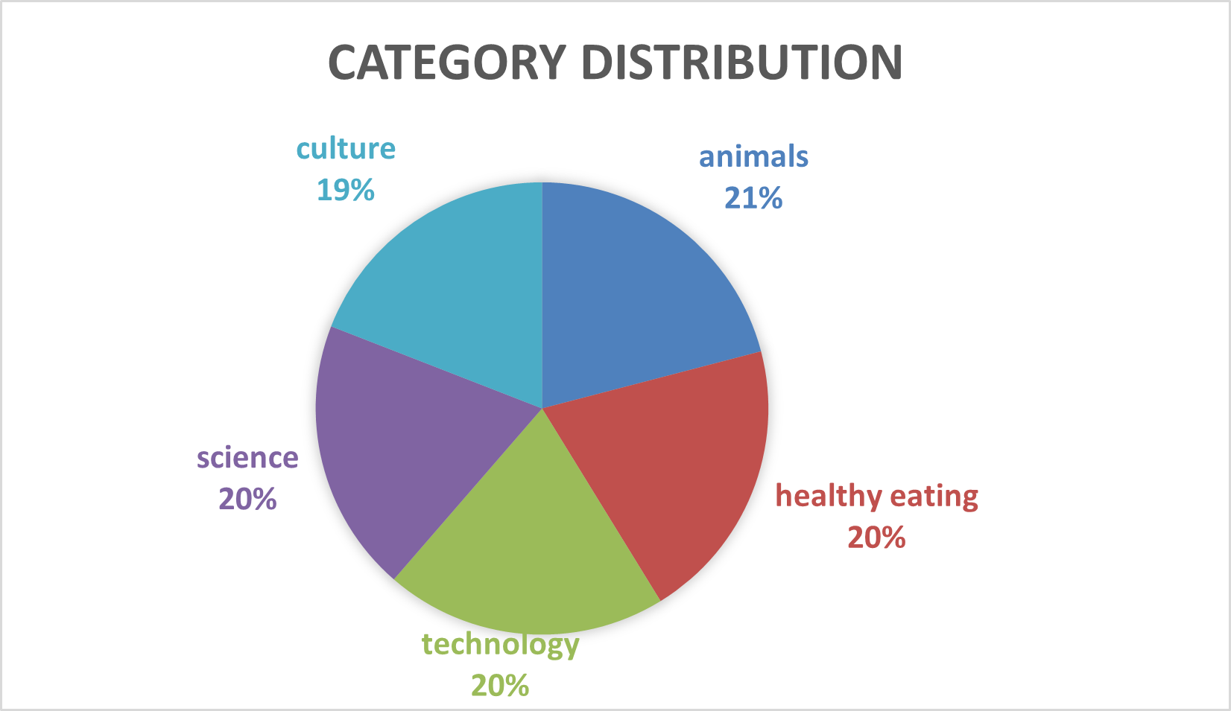

Slide 10

The category "Animals" is the most popular and generates the highest user engagement.
There is a significant spike in user activity in May, suggesting seasonal trends.
Summary

Slide 11
Thank you!
ANY QUESTIONS?

